Slide 1
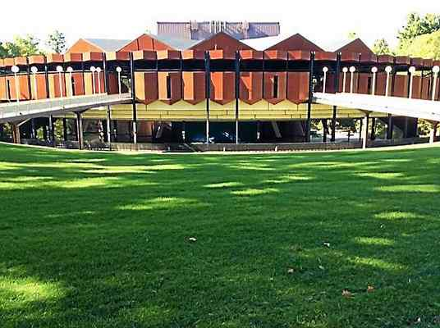
Saratoga Performing Arts Center Classical Kids Program
With Hot Club of Saratoga
Notes:
INTRO
PLAY: upbeat selections from our repertoire as kids enter
ZACH, DYLAN, TUCKER INTRODUCE THEMSELVES IN DIFFERENT LANGUAGES. CHUCK & JONATHAN ACT CONFUSED.
Jonathan, what are they talking about? Do you understand them?
SOMEONE SAYS SOMETHING DIRECTLY TO CHUCK ABOUT A TUNE OR SOMETHING --- CONFUSION --- ZDT START LOUDLY DISCUSSING IN LANGUAGES
JONATHAN STARTS TO PLAY – We all join in….
Ah, you see we finally understood once the music started. THEN we were communicating!

Slide 2
Music Is A Language
Music can communicate ideas & feelings.
Notes:
1-2 INTRODUCTION
That’s because music is a language. And it’s a language that the 5 of us share.
Well, good morning everyone. I don’t know when they learned French, Russian, and German. But I think they were say hello.
We are The Hot Club of Saratoga.
I am Chuck. I play rhythm guitar.
This is Jonathan who plays clarinet.
In English now, Tucker, Zach, Dylan introduce themselves in English.
Your school and SPAC have invited us to come this morning to talk about music.
How many of you like to listen to music?
Raise your hand if you understood anything Zach, Dylan, and Tucker were saying before when they introduced themselves.
Think of language ….talking with each other. I say talking with because talking with means we are also listening as well as talking.
Listening is important.
When someone talks to you and you listen, it paints a picture in your mind.
How many of you just pictured someone painting a picture?
We can create whole worlds in our heads from the words we hear or read.
Music can do the same. It can remind us of things from our past, bring up feelings that surprise us sometimes, paint pictures in our minds.

Slide 3
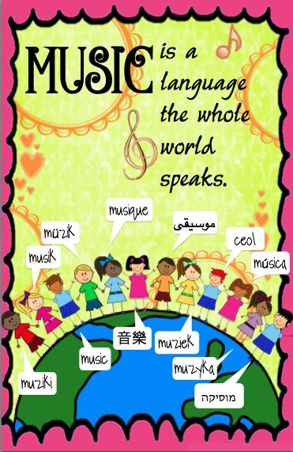
Notes:
3 MUSIC IS A UNIVERSAL LANGUAGE THAT CAN CONNECT PEOPLE
…and it is a language everyone can understand.
Like many languages, it can be spoken …written …sung.
….And music can be played.

Slide 4
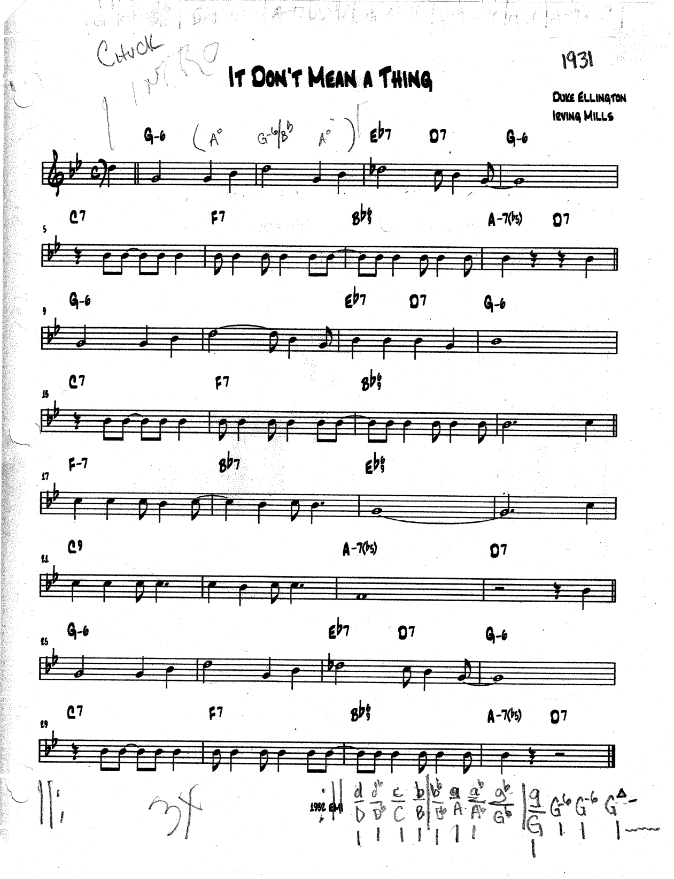
Though it may be called many things, we usually call this a lead sheet. It Don’t Mean A Thing …depending on what language you understand.
Notes:
3.2 MUSIC AS A WRITTEN LANGUAGE
Here is a simple example of musical language when written.
In some types of music, people play pretty much exactly what is written.
Irish/Celtic, Old Time, Classical, a student just learning
In musical styles people IMPROVISE- create music in the moment – while they are playing.
Blues, Rock, Jazz, Hip-Hop, Rap
We are Hot Club of Saratoga and we play gypsy jazz. In our style we play (and in this tune, sing) pretty much what is written the first and last time through. In between there is a lot of improvising, the soloists making things up as they are playing.
Give a listen to “It Don’t Mean A Thing If It Ain’t Got That Swing”
PLAY: IT DON’T MEAN A THING

Slide 5
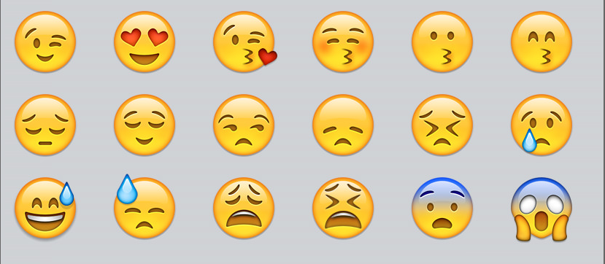
Music Communicates Emotion
Notes:
4. MUSIC COMMUNICATES EMOTIONS
How much does the music add to what you feel when watching a movie?
Does it add suspense? Can it make you feel happy …or sad?
Would you feel things as strongly with the soundtrack? Try a little experiment sometime when you’re watching a movie at home. Turn the sound off, see if there’s a difference. Especially during a chase scene, or a scary scene when you’re waiting for something to happen, or when something sad, or really happy happens. Does the music make you feel more than just the pictures do?
Let’s try something. Here are 5 feelings you might see in movies.
Sad Happy Excited Scared In Love
We are going to play a short piece. Listen as we play and see which one of these feelings you get from each piece. You may even want to close your eyes as we play.
PLAY PIECES ASKING FOR SHOW OF HANDS FOR EACH FEELING AFTER EACH
FLIGHT OF BUBMBLEBEE -- excited
SUPER MARIO -- happy
BLUE DRAG AS DURGE -- sad
MICHAEL MYERS THEME -- scared
LA VIE EN ROSE -- in love

Slide 6
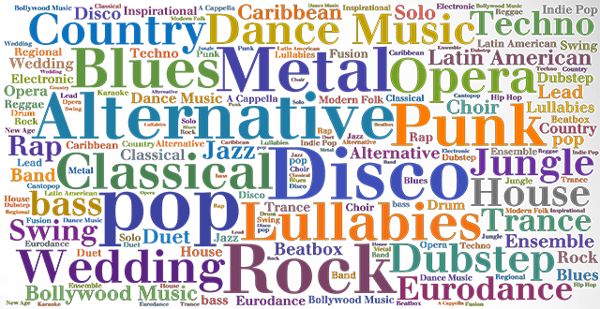
Musical genres/styles are like different dialects or accents …like different shades of the same color.
Notes:
5 DIFFERENT STYLES OF MUSIC CAN BE LIKE DIFFERENT LANGUAGES OR MORE AND MORE IN A GLOBAL WORLD DIFFERENT ACCENTS AND DIALECTS.
Music has been with people as long as people have existed, perhaps starting with grunts, groans, cries of pain and shouts of joy!
As people changed and their habits became more complicated and different, so did their music.
And so has the way we talk about music with each other.
… Before we get to that, we want to show you how one piece of music might sound if it were played in different musical styles.
The piece is commonly called “”Canon in D” or Pachelbel’s Canon. It was written sometime in the 1690’s by the German composer Johann Pachelbel.
First we’ll play it as written. Most people would call the style CLASSICAL
Now the same piece in Hot Club of Saratoga’s style of music, SWING
METAL
REGGAE
BLUEGRASS
Sounds a bit different in each style, doesn’t it?

Slide 7
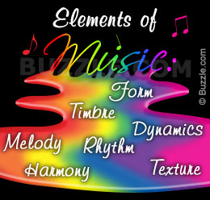
Notes:
6 ELEMENTS OF MUSIC
Musicians use many terms to talk about music, to communicate their ideas with each other. Let’s explore just a few examples.

Slide 8
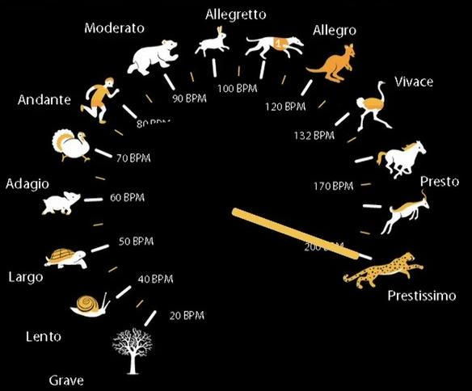
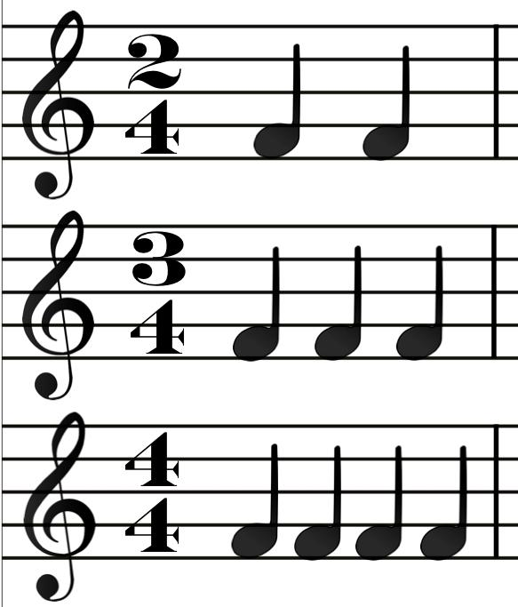
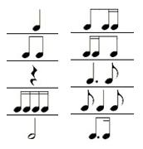
Rhythm
Speed
Limit
Overall Pattern of Movement
Flow Within the Piece
> Swing <
> Bossa <
Arrangement of Notes and Spaces
Notes:
6.1 RHYTHM
RHYTHM is about the speed and the flow of time through the music.
It tells us the overall flow of the piece or section. For example do we group beats in 2s, 3s, 4s, 5s or even more.
(Time Signatures – are like fractions, 2/2, 3/4, 4/4, 5/4, 6/8, etc. )
PLAY : Just rhythm section demonstrate these:
3/4 ANNIVERSARY WALTZ
4/4 COQUETTE – swing
5/4 TAKE 5
Rhythm also describes how a piece is played, how notes and rests are arranged.
Within solos rhythm makes it more interesting. If you understand rhythm patterns you can use it in improvising solos.
What if the soloist chose all the same rhythms for a whole solo?
PLAY: a small solo segment with just quarter notes, then eighth >>>CONSIDER CUT TO SHORTEN<<<
But listen to the difference when he mixes things up playing some long, some short, letting there be space, or rests, between some notes.
PLAY: really play a solo …being sure to clearly leave some space. >>>CONSIDER CUT TO SHORTEN<<<
And part of what rhythm does is tell us the speed of the music
PLAY AFTER YOU’VE GONE --- FAST – SLOW – FAST >>>CONSIDER CUT TO SHORTEN<<<

Slide 9
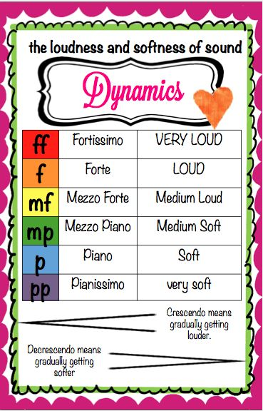
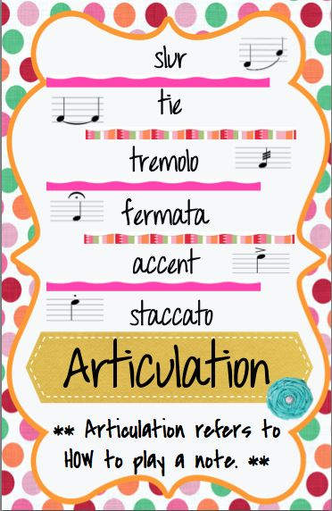
Dynamics & Articulation
Notes:
6.2 DYNAMICS AND ARTICULATION
We have to decide whether to play parts or notes loud or soft, short or long, smooth or choppy.
Listen to Jonathan and Tucker play part of a movie theme similar to the way you probably know it.
PLAY: JURASSIC PARK --- legato
How did that sound to you? Stiff. And. Separate. Or flowing_and _connected. That’s called legato.
Now let’s have them play it a bit differently, called staccato.
PLAY: JURASSIC PARK --- stoccato

Slide 10
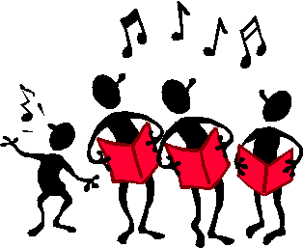
Melody is like a path we follow…
If we add more voices or instruments we begin to hear harmony
Notes:
6.3 MELODY AND HARMONY
J OR T PLAY A MELODY BEHIND ME as I say…
Melody is like a path we follow, it takes us up and down, it stops and starts, it’s long and short notes all together in a flow of sound.
Adding more voices or instruments around the melody adds layers and richness to the music. This is called harmony.
Listen as we play Pachelbel, a classical piece you may have heard.
It starts with just a lone melody line, a walk down a path by yourself. Then more instruments join in to add harmonies and a richer, fuller sound.

Slide 11
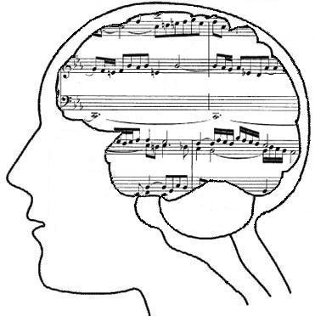
These things can have a great effect on the mood or feeling of music.
Notes:
6.3 MAJOR AND MINOR HARMONIES
All this and more can change the feel, the mood, the path of the music.
Listen to the difference when we change the harmonies in this piece.
PLAY “Jurassic Park” in major (as written)
Now listen as we play it but this time making the harmonies minor.
PLAY “Jurassic Park” in minor
Musicians use all these different ideas to create their music, to create different feelings, to paint different pictures in your mind.
These are just some of the things that we think about to make music. But you don’t need to study all these things to begin making music.

Slide 12
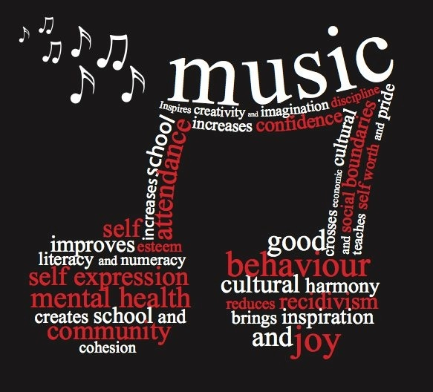
Do you hear the music in your life?
Notes:
7 & 7. 4.3 WHO CAN BE MUSICAL?
Many people have music in their lives in many ways. Do you?
Listening or participating in music can be fun, can be inspiring, can help you through tough times.
You can do it for fun, by yourself, or with friends.
Practice some and you can perform some for the people around you or with friends.
Learn and practice some more and you could play music for some extra money.
And, of course, some people have careers in music!
If you want to make music and something is stopping you, consider the following…..

Slide 13
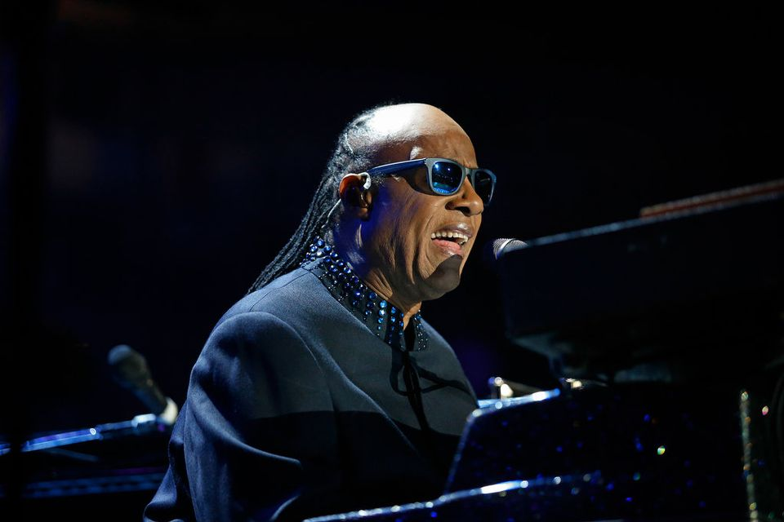
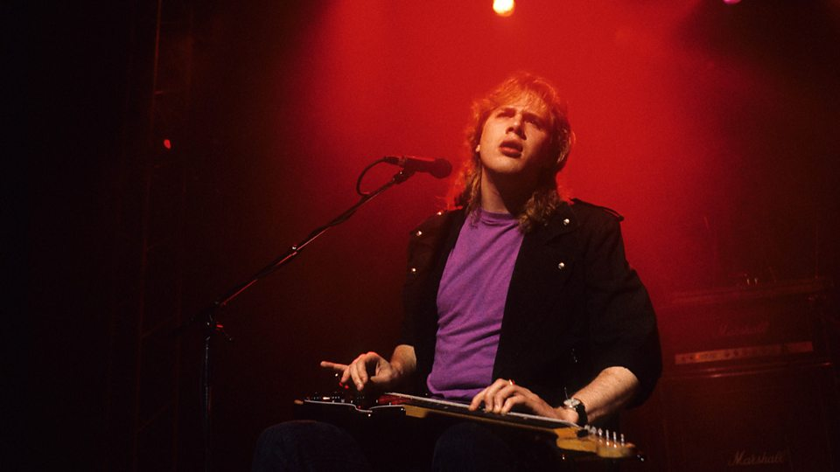
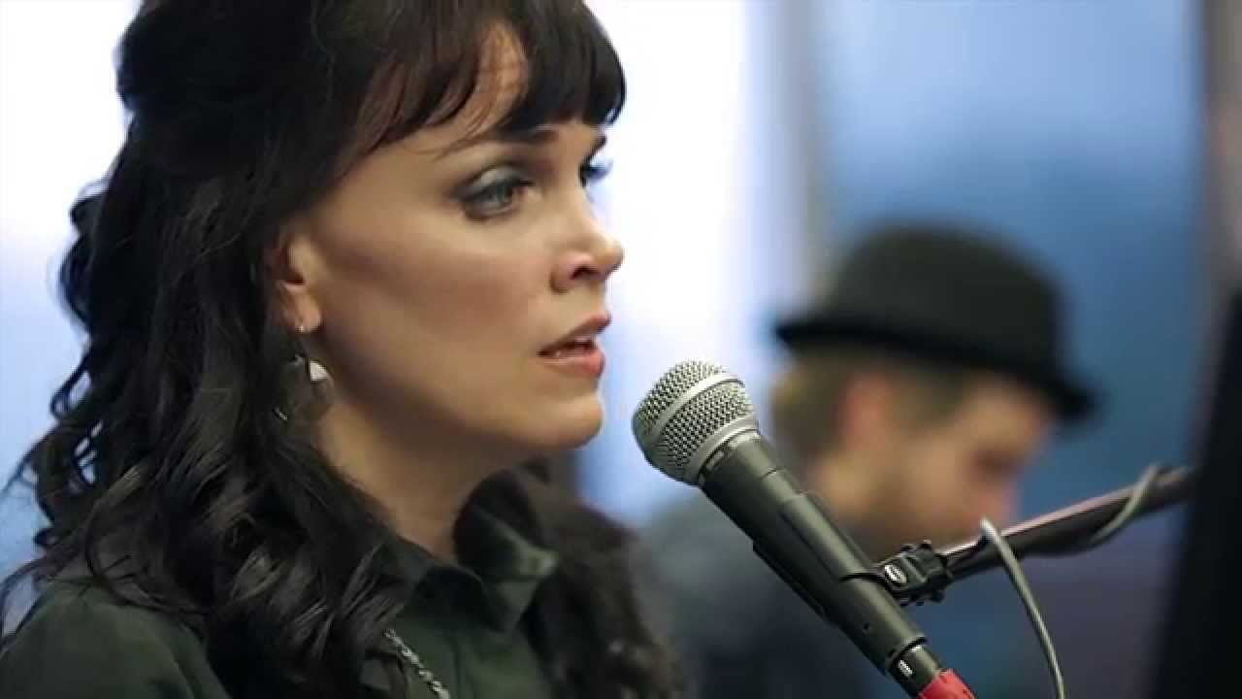
Being blind didn’t stop Stevie Wonder!
… or Jeff Healey, who played the blues!
… or singer songwriter Ginny Owens.
Notes:
7
Stevie Wonder, Jeff Healey, Ginny Owens, and several other musicians have made great music despite being blind.

Slide 14
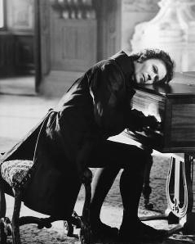
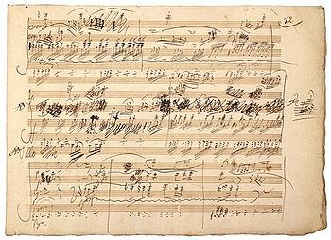
Becoming deaf didn’t stop Beethoven from continuing to compose music.
Notes:
7
Beethoven composed music after he lost his hearing. And if you think that he, like all musicians, didn’t edit his work, look at this page of music he wrote.

Slide 15
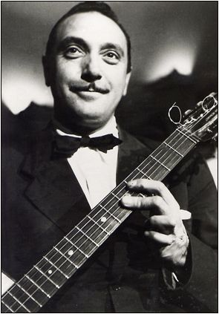
…and look at Django Reinhardt’s left hand.
His 3rd and 4th fingers were stuck in that position.
Notes:
7.3
This is Django Reinhardt. He was a gypsy living in France who began playing music professionally in the clubs around Paris when he was about 12 years old.
He was badly burned in a fire when he was 18. He almost lost his leg and his fingers were partially paralyzed putting him into the hospital for almost a year. He spent 1-2 years figuring out how to play again, mostly with just his 2 good fingers.

Slide 16
And started a whole new style of music called Gypsy Jazz of Gypsy Swing!
So Django played all his solos with just 2 fingers!
Notes:
7.3
We mention him today because in spite of his injuries, he started a new style of music. It is the music style of music that we play we play called gypsy jazz, or gypsy swing.
Imagine all the playing, all the notes that Zach plays for you today being played with just 2 fingers.
We’ll play a tune Django wrote now called “Micro”. Imagine playing it all on guitar with just 2 fingers!
PLAY: MICRO

Slide 17
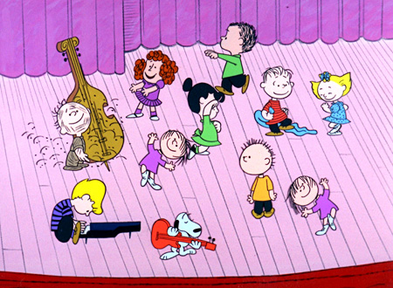
You probably are already doing music!
Notes:
7.4 YOU ARE MUSICAL
You probably are already doing music!
Raise you hand if you hum tunes to yourself.
Whistle? Sing? Tap your foot or clap to the beat?
Dance a bit or move a little differently when there is music on or even just in your head?
Raise your hand if you had some song or rhythm in your head sometime today.

Slide 18
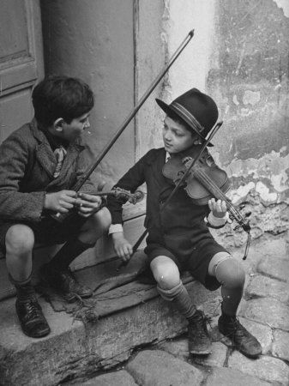
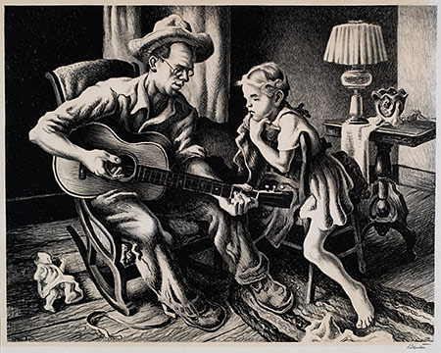
The Folk Process
Family and friends
Trial and error – see what works
Learn by doing
Notes:
7.4.1 THE FOLK PROCESS
You’ve probably already learned a bunch of music just by noticing and copying what people around you do.
In fact, it’s Dylan’s birthday today! What do you say we sing to him? “Haaaaapy Birthday to you……. drift off let them sing.
Uh-huh. Did someone actually teach you that song…. Or did you just learn it by hearing it so often.
You learned it by ear! ….by LISTENING!

Slide 19
LISTEN
Notes:
7.4.2 LISTENING IS THE MOST IMPORTANT SKILL IN MUSIC
Listening is the most important skill in music.

Slide 20
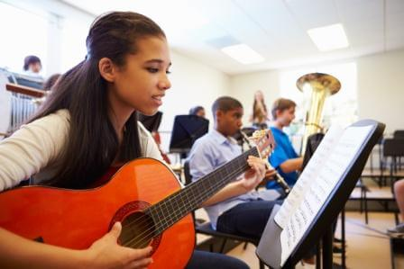
EDUCATION – TRAINING -- PRACTICE
Notes:
7.4.4 EDUCATION – TRAINING – PRACTICE
Training and practice can be a real shortcut to develop skills and learn new things.
My 4 bandmates here are all classically trained musicians, as well as in jazz. As a result of that training and practice, they can play just about any kind of music they want.
And even now we all still sometimes take more lessons to learn new ways to do things and break out of old patterns into new creative ideas with added training and practice.

Slide 21
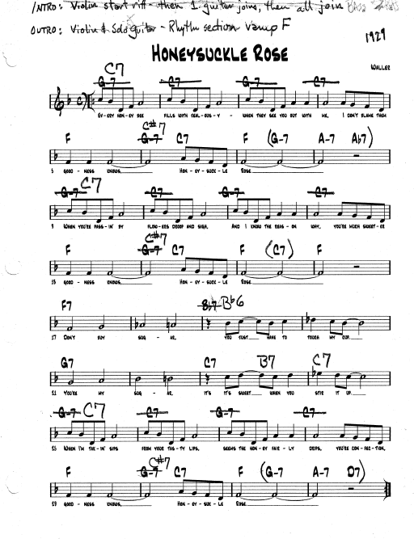
PLAYING WITH OTHERS
Notes:
8 PLAYING WITH OTHERS >>>>>>>>>> CONSIDER ABBREVIATING IF TIME IS LONG <<<<<<<<<<<<<<<<<
Like when you’re playing a game together, when playing music together we follow rules like rhythm and the other parts of music we have talked about.
But there is a lot of flexibility in the rules, especially in jazz, so understanding the language of music allows us to play and communicate how we want to play something.
Sometimes we plan things out ahead of time.
Often we do things a little different each time. But because we know the language, and we listen to each other while playing, we can change things quickly.
This is a song we do often, but do it differently at time depending on who we are playing with.
How should we do it today, gentlemen?
DISCUSS FORM & PLAY: “Honeysuckle Rose” >>>CONSIDER SUTTING TO SHORTEN<<<
There are 5 of us who plan and listen to each other so we can play well.
But what if there were more of us, like our bass player, Dylan, also has a big band with 12 or 13 musicians
Or what about The Philadelphia Orchestra who is at SPAC every summer?

Slide 22
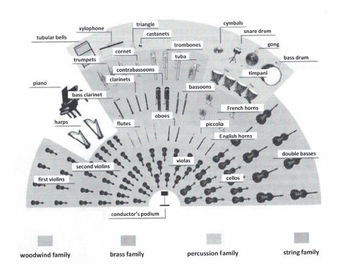
What about a full orchestra?
The Philadelphia Orchestra
is
96
musicians playing together.
Notes:
8.4 THE ORCHESTRA AND THE CONDUCTOR
If it’s important for the 5 of us to listen, how do you think a whole orchestra can play together?
This image from your guide shows the sections of the orchestra.

Slide 23
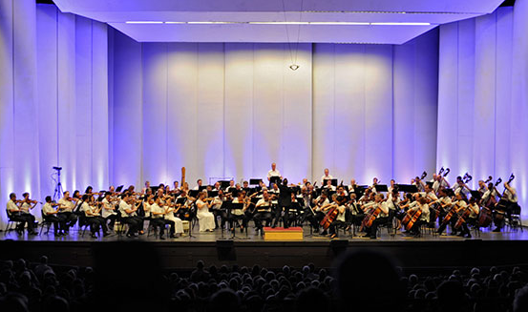
The Philadelphia Orchestra at SPAC
Notes:
8.4.2 THE PHILADEPHIA ORCHESTRA AT SPAC
And here are the 96 musicians who are the Philadelphia Orchestra in their sections on the SPAC stage.

Slide 24
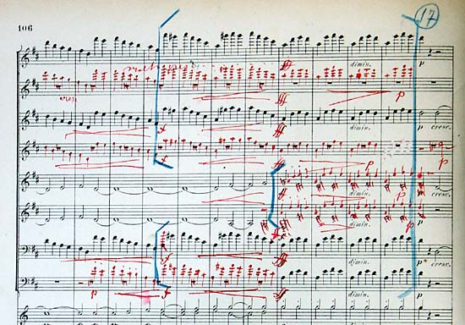
And the music can get pretty complicated.
Notes:
8.3 THE MUSIC ITSELF CAN BE COMPLICATED
This is just a small part of the score, the music for the entire orchestra, of Beethoven’s Ninth Symphony.
This is actually the score that one famous composer, Gustav Mahler, used when he conducted an orchestra playing Beethoven’s music.
Notice all the red and blue he used to plan how he wanted the orchestra to play this music.

Slide 25
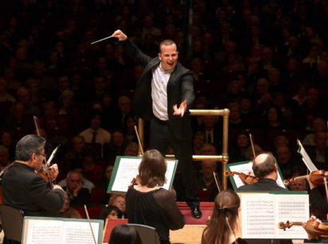
The Conductor
Notes:
8.4.2 THE CONDUCTOR
Along with their conductor, the person who plans how to play the pieces, who is in the perfect spot to listen, and keeps everyone together, the Philadelphia Orchecstra brings the music to life at SPAC every summer.

Slide 26
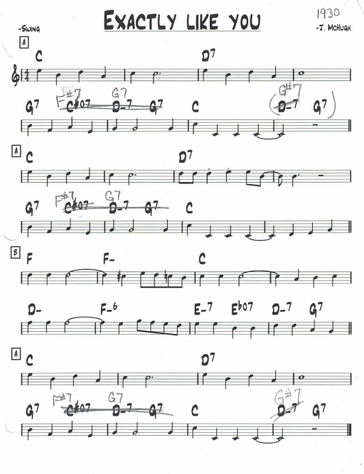
Listening and also following a conductor.
Notes:
8.4.2 LISTENING AND FOLLOWING A CONDUCTOR >>>> SCHOOL OPTION <<<<<
To help us demonstrate how musicians might follow a conductor, we have invited one of you teachers to conduct us in a song.
So at this time we’d ask ________________________________ to come up with us and take the baton – or in this case a chopstick to conduct us in “Exactly Like You” .

Slide 27
Music tells a story. It can take us on a journey. It can spark memories from the past and imagination of worlds to discover.
Notes:
9 MUSIC TELLS A STORY
Music tells a story.
Music sparks memories.
Music makes us feel things.
Music inspires.

Slide 28
Do these tunes spark any memories?
Notes:
9.1
We’re going to play some short tunes.
See if you recognize them, if they bring some feelings to you.
PLAY:
FLINTSTONES
FAMILY GUY
SPONGEBOB

Slide 29
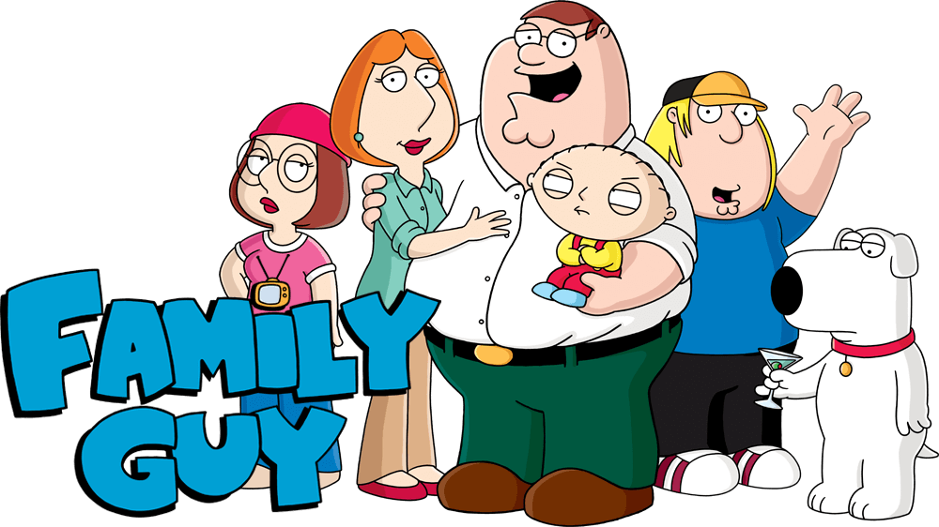
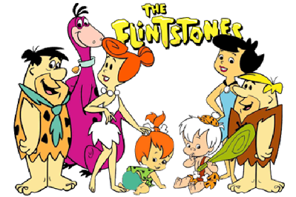
Notes:
9.1
Flintstones – Family Guy – Spongebob Squarepants

Slide 30
Hans Zimmer
The Boss Baby
Kung Fu Panda Movies
The Lion King
Madagascar Movies
Pirates of the Caribbean Movies
Notes:
9.1 INTRODUCE HANS ZIMMER CLIP
Hans Zimmer wrote the music for many famous movies. The ones listed here are only a few examples. This is what he had to say about it.

Slide 31
Notes:
HANS ZIMMER

Slide 32
Notes:
9.1.5 Jurassic Park
PLAY: JURASSIC PARK THEME

Slide 33
EDUCATION – TRAINING -- PRACTICE
Notes:
9.1.6 STAR WARS
PLAY: STAR WARS MEDLEY

Slide 34
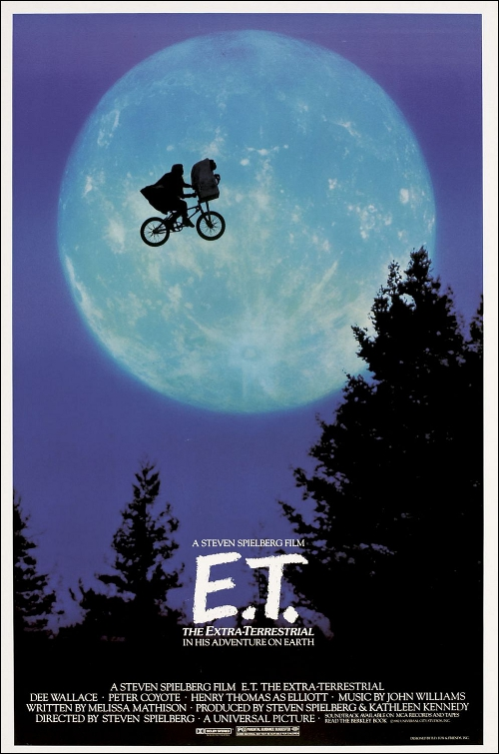
Notes:
9.1.7 ET
PLAY: ET THEME

Slide 35
Music is a language. Music tells a story
Notes:
Music is a language. Music tells a story.

Slide 36
Notes:
END

